Slide 1

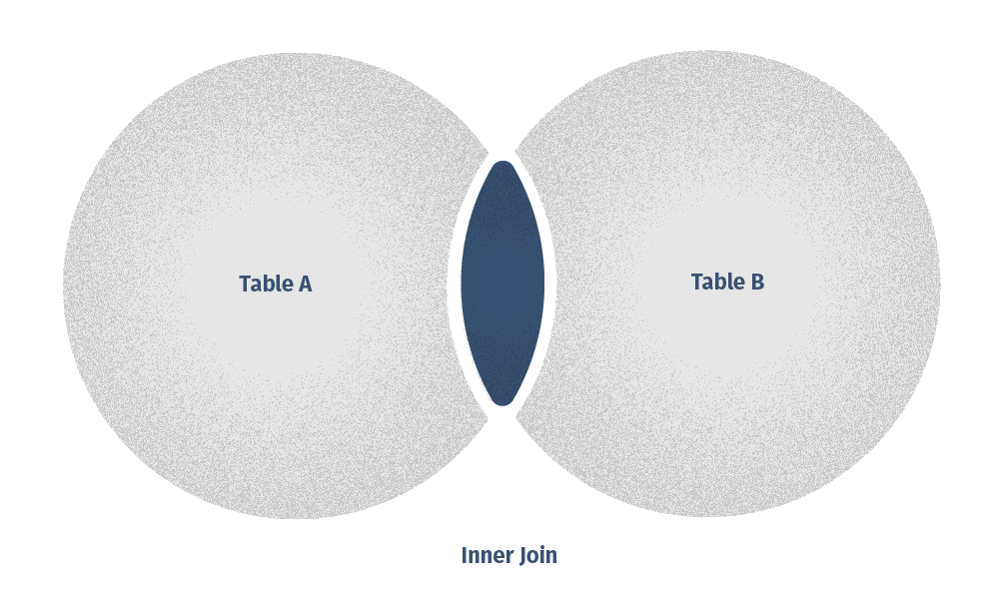
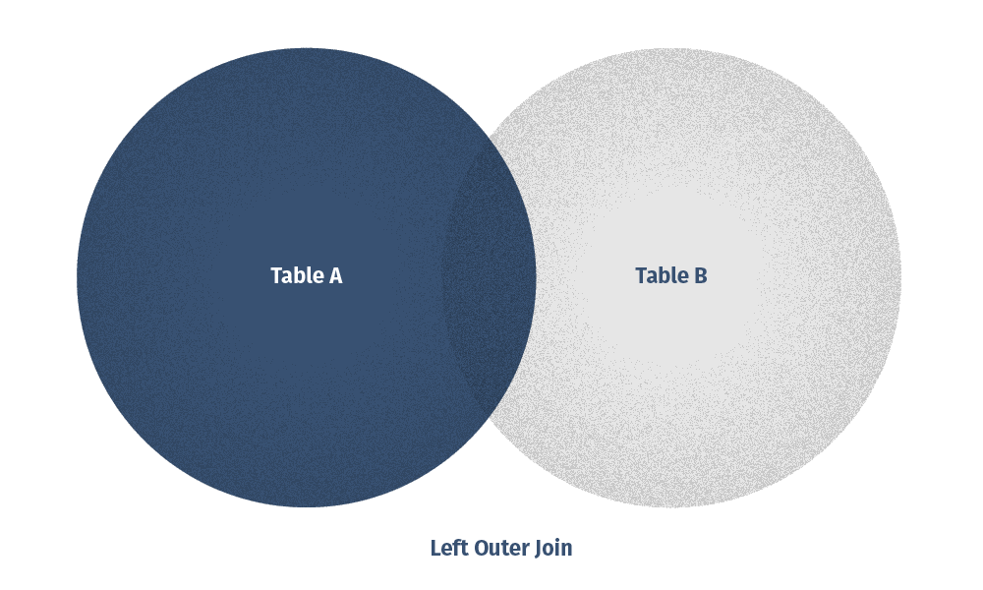
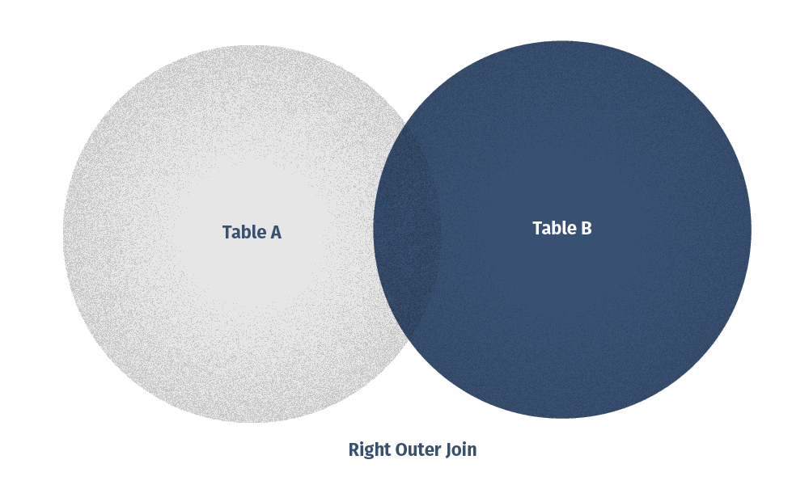
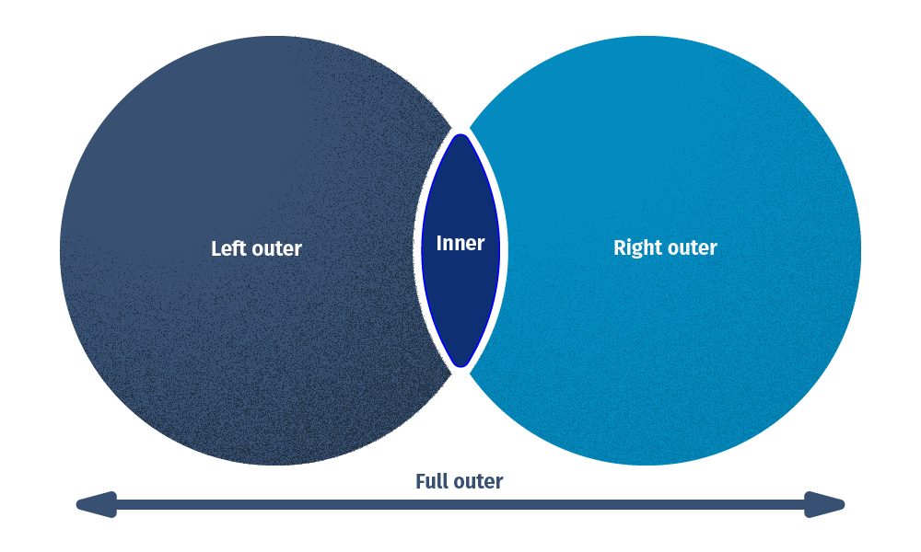
RELATIONAL JOINS
SELECT col1, col2, . . .
FROM table_a
JOIN_TYPE table_b
ON table_a.col = table_b.col;

Slide 2
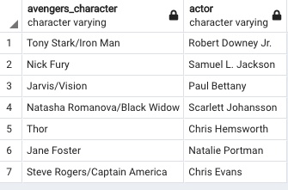
LEFT JOIN
avengers
star wars
SELECT avengers.character,
avengers.actor,
star_wars.character
FROM avengers
LEFT JOIN star_wars
ON avengers.actor = star_wars.actor;

Slide 3
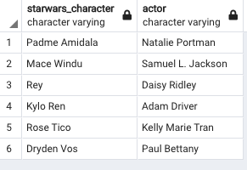
RIGHT JOIN
avengers
star wars
SELECT avengers.character,
star_wars.actor,
star_wars.character
FROM avengers
RIGHT JOIN star_wars
ON avengers.actor = star_wars.actor;

Slide 4
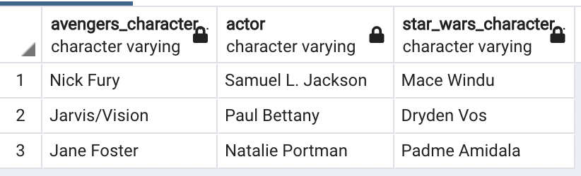
INNER JOIN
avengers
star wars
SELECT avengers.character AS avengers_character,
avengers.actor AS actor,
star_wars.character AS star_wars_character
FROM avengers INNER JOIN star_wars
ON avengers.actor = star_wars.actor;

Slide 5
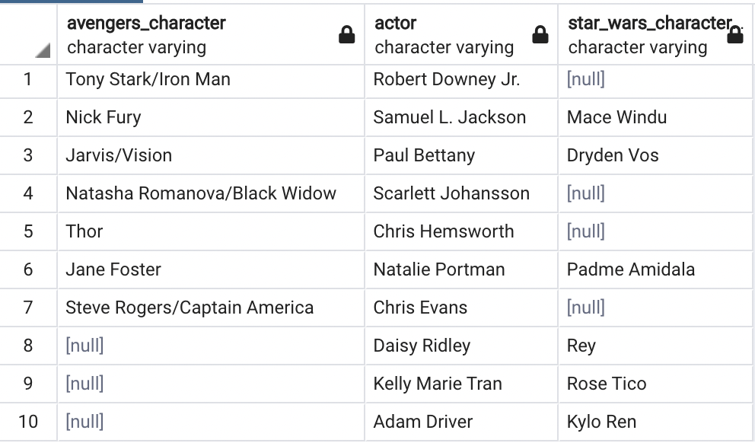
FULL OUTER JOIN
avengers
star wars
SELECT avengers.character AS avengers_character,
CASE WHEN avengers.actor IS NULL THEN star_wars.actor
ELSE avengers.actor END AS actor,
star_wars.character AS star_wars_character
FROM avengers FULL OUTER JOIN star_wars
ON avengers.actor = star_wars.actor;

Slide 6
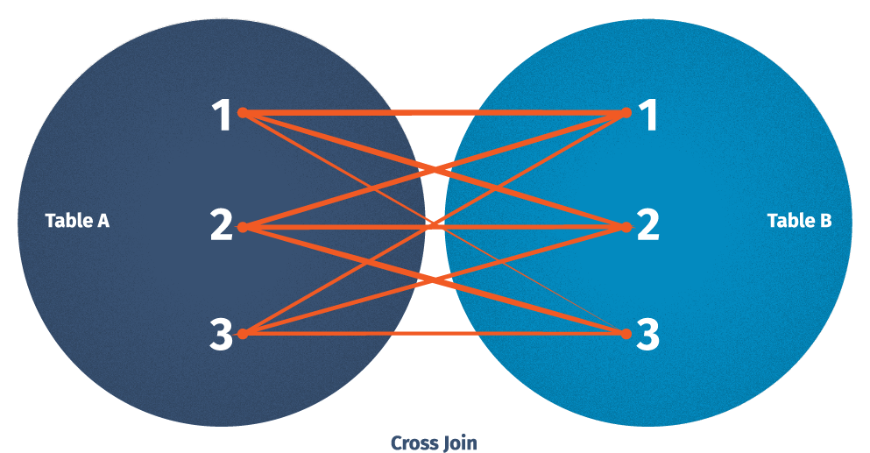
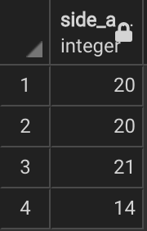
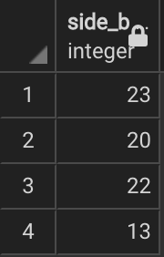
CROSS JOIN (Cartesian Product)
*CASE:
Given one side of a triangle is 40,
how many different combinations are
there in which we can form a triangle?
SELECT a, b
FROM table_a
CROSS JOIN table_b;

